Slide 1
Legal Framework and OHS Management System
Lecture # 3
Prepared by:
Ms. Sadia Tariq

Slide 2
Background
Occupational health and safety, a global issue, is now taking a new turn.
Reasons : rapid industrial and agricultural development that are taking place in the developing countries.
Many of these countries are moving from manual labour to service mechanization in the main productive sectors.
Health problems also changed. Eg . Ergonomics

Slide 3
Benefits of OHS
The benefit of occupational health service in developing countries is
seen locally as well as on a national level.
The positive impact of occupational health service locally may be observed in reducing morbidity and work-related injuries.
This also means fewer losses to employer and worker as there will be a reduction of wage losses and decreased compensation costs.
The reduction of absenteeism is of great importance concerning skilled labour, especially so in countries where there is a shortage of skilled labour.

Slide 4
OHS Definition
OHS is concerned with preserving and protecting human life and resources.
According to WHO (1995), occupational safety and health can be defined as a multidisciplinary activity aiming at:
Protection and promotion of the health of workers by eliminating occupational factors and conditions hazardous to health and safety at work
Enhancement of physical, mental and social well-being of workers and support for the development and maintenance of their working capacity, as well as professional and social development at work
Development and promotion of sustainable work environments and work organizations.
The ILO/WHO definition of occupational health is
“The promotion and maintenance of the highest degree of physical, mental social well- being of workers in all occupation”

Slide 5

Occupational Safety and Health Act

Slide 6
History
In early 20th century U.S. federal and state agencies began
investigating health conditions in industry.
In 1908, public awareness of occupationally related diseases stimulated the passage of compensation acts for certain civil employees.
States passed the first workers' compensation laws in 1911.
All states enacted such legislation by 1948.
The U.S. Congress has passed three landmark pieces of legislation related to safeguarding workers' health:
the Metal and Nonmetallic Mines Safety Act of 1966,
the Federal Coal Mine Safety and Health Act of 1969, and
the Occupational Safety and Health Act of 1970 (OSH Act).
Today, nearly every employer is required to implement the elements of an industrial hygiene and safety, occupational health, or hazard communication program and to be responsive to the Occupational Safety and Health Administration (OSHA) and its regulations.

Slide 7
OHS Management System
An OSH management system is:
“A set of interrelated or interacting elements to establish OSH policy and objectives, and to achieve those objectives.”
Key elements of OHS management systems are:
Planning
Implementation and operation
Measuring performance
Auditing
Reviewing performance

Slide 8
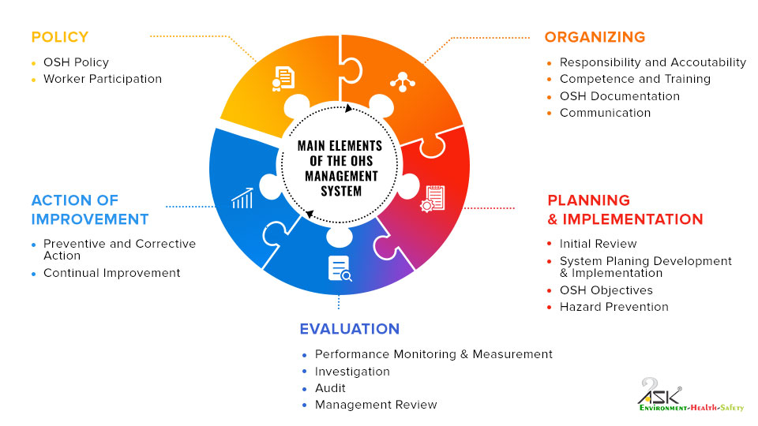

Slide 9
OSHA
OSHA stands for "The Occupational Safety and Health Administration" and is a federal agency that establishes on-the-job safety protections for workers.
Objective of OSHA:
The main objective of OSHA 1994 is to secure the safety, health & welfare of employees at work against any workplace hazard & risk-activities involved.
It is the requirement of the employer to ensure that there is an effective system in-place, employee's participation & continual improvement in the management of OSH.
Importance of OSHA:
Occupational health and safety plays such a pivotal role in the workplace; it ensures that relevant safety and health standards as well as procedures are carefully observed to guard against potential occupational hazards.

Slide 10
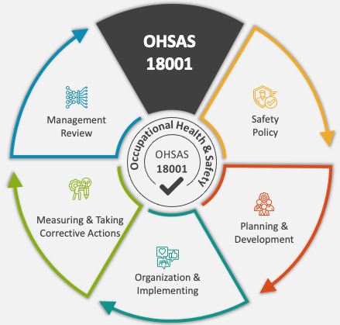
OSHAS 18001
OHSAS 18001 focuses on controlling hazards.
It provides a framework for the effective management of occupational health and safety including all aspects of risk management and legal compliance.
It addresses occupational health and safety rather than any specific product safety matters.
Organizations already certified to OHSAS 18001 have until March 2021 to comply with the new ISO 45001 standard if they want to maintain recognition (certification of conformity to ISO 45001 is not a requirement of the standard).

Slide 11
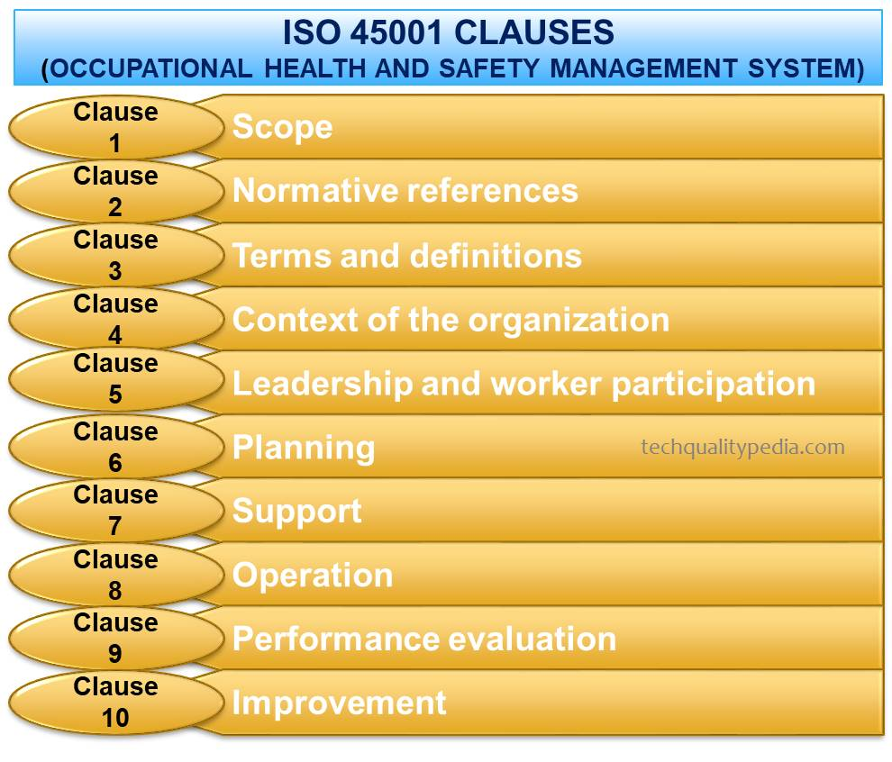
ISO 45001
ISO 45001 is a global standard for Occupational Health and Safety Management Systems that provides a practical solution to improve the safety and health of both employees and other personnel.
This ISO 45001 standard has been designed to apply to any company regardless of its size, type and nature.

Slide 12
